Slide 1
Unconscious Bias: Implications for healthcare delivery
Ethics Week
November 7th, 2023
Sean Polreis
www.usask.ca
Notes:
Session for Ethics Week @ St. Paul’s Hospital (Pylypchuk Hall). Contact with Dr. Mary Heilman. Part II of 2.
45 minutes with 15-minute Q & A.
Below is the description they used for promoting this session.
Unconscious Bias: Implications for healthcare delivery. In this session we will look at a variety of ways in which unconscious bias can influence patient care. We will examine a variety of viewpoints, including public health messaging, patient & colleague interactions, diagnosis/treatment, & patient outcomes. We will conclude by discussing some strategies to help mitigate some of the negative impacts of unconscious bias.

Slide 2
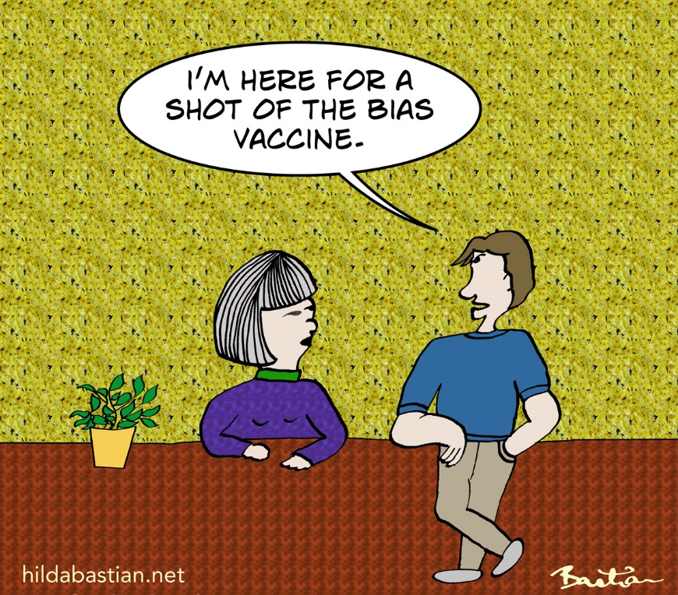
Faculty/Presenter Disclosure
None
All images are attributed, PP stock, copied with permission, or from istockphoto.com
Creative Commons © Hilda Bastian
Notes:
Make a disclosure that this session will NOT be free of bias. My first bias is that I like using humour & comics.

Slide 3
November 6 takeaways
Unconscious bias involves automatic, unintentional associations/assumptions
Unconscious bias can influence our understanding & our behaviour
Bias is a product of our biology as well as our socio-cultural experiences
An initial strategy involves acceptance, awareness, & deliberate thinking
Notes:
It happens automatically. Note, not explicit bias.
Even when we try to be objective our biases filter the data we take in. Next example of Facebook will demonstrate this.

Slide 4
We need to overcome the discomfort that comes from incompatibility of unconscious bias with our conscious perception that we are good people.
Notes:
Cognitive dissonance is created when we are confronted with the fact that our unconscious sometimes does not align with our conscious perception of who we are & what we believe. We need to accept the fact that we all have everyday bias.
In psychology this is known as compartmentalization or compartmentalized identity - a subconscious psychological defense mechanism used to avoid cognitive dissonance, or the mental discomfort and anxiety caused by a person's having conflicting values, cognitions, emotions, beliefs, etc. within themselves.

Slide 5
Learning objectives
Describe implications of unconscious bias in healthcare
Types of bias
Areas of healthcare
Public health messaging
Patient & colleague interactions
Diagnosis/treatment
Patient outcomes
Describe strategies to reduce the negative impacts of unconscious bias
Notes:
Goal is to embrace our biases, understand them, & have discussions about them.
This is not about blame or guilt. It’s about understanding, awareness, & improvement. It should be informative, interesting, & fun.

Slide 6
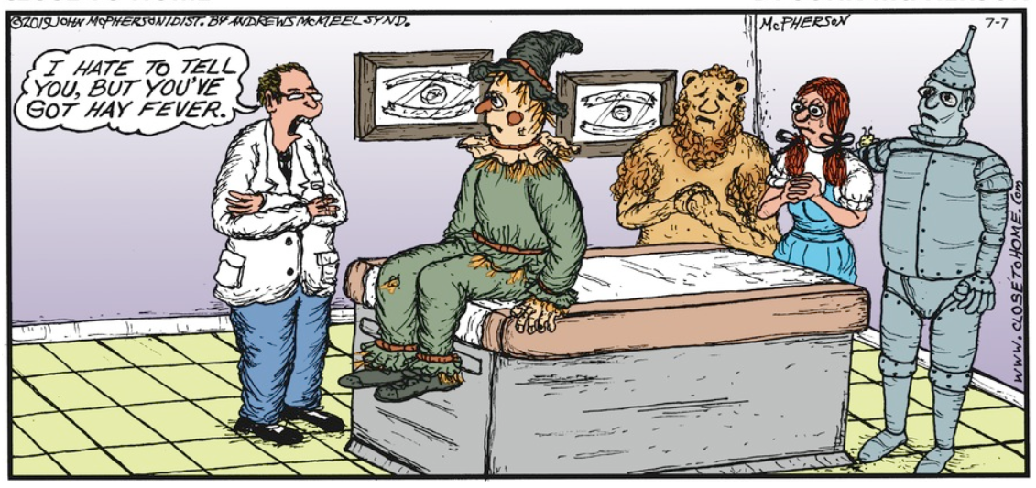
1) Implications in healthcare
© Andrews McMeel Syndication; Close to Home by John McPherson; 7/7/2019
Notes:
Session for Ethics Week @ St. Paul’s Hospital (Pylypchuk Hall). Contact with Dr. Mary Heilman. Part II of 2.
45 minutes with 15-minute Q & A.
Below is the description they used for promoting this session.
Unconscious Bias: Implications for healthcare delivery. In this session we will look at a variety of ways in which unconscious bias can influence patient care. We will examine a variety of viewpoints, including public health messaging, patient & colleague interactions, diagnosis/treatment, & patient outcomes. We will conclude by discussing some strategies to help mitigate some of the negative impacts of unconscious bias.

Slide 7
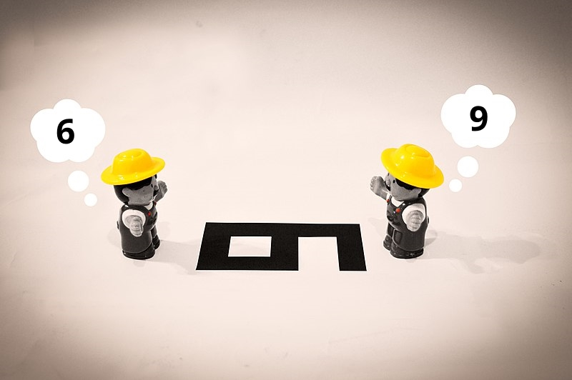
a) Types of bias
Notes:
Think about how the following may impact you in healthcare. Remember you are thinking primarily about diagnostic decisions & communication.

Slide 8
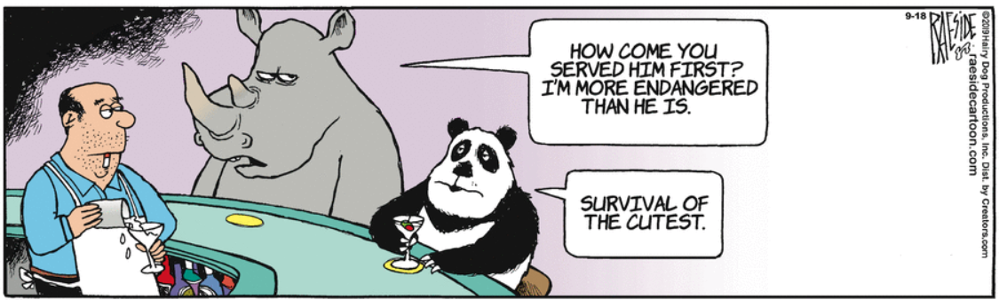
Affect heuristic bias
“1st impression” (positive or negative) feelings in relation to a stimulus
What stimuli are leading to the bartender bias?
© The Other Coast, Adrian Raeside, 9/18/2019
Notes:
Many different “types” of bias.
Decisions heavily influenced by your emotions. “gut feeling” bias. This one basically describes unconscious/everyday/implicit bias.
Heuristic is a shortcut that allows us to make decisions quickly & efficiently.
Warmth & competence are 2 primary things we immediately look for in people. Automatically. Much social psychology research in this area.
A fun study to illustrate this one is the influence of in-store music on wine selection. When French music was played, more French wine was purchased. When German music, more German wine. 2 week study, music alternated day to day. Customers were unaware of the effect.
North, A. C., Hargreaves, D. J., & McKendrick, J. (1999). The influence of in-store music on wine selections. Journal of Applied psychology, 84(2), 271.
There are dozens/hundreds of types of bias.
Ask what is the stimulus leading to the bias demonstrated in the cartoon. Attractiveness is the specific stimulus playing out here. This is an example of taxonomic bias – more attention (research, government, & public) given to certain animals.

Slide 9
Any “gut” feelings?
Notes:
Ask them to think of all the things that may be influencing their gut feeling & feelings of warmth & competence about these doctors.

Slide 10
Affect heuristic bias – ex: of stimuli
What are some factors that may influence how we feel about someone or something?
Notes:
Heuristic is a shortcut that allows us to make decisions quickly & efficiently.
Brainstorm with the group a list of things that might influence a person’s affective heuristic bias. I.e. “when you meet someone, what things might come into play for this”? I have 16 on the slide – things that might influence me on whether I think someone is warm/competent.
Might want to break this down into categories of stimuli? Appearance, weather, smell, time of day, etc.

Slide 11
Affect heuristic bias – ex: of stimuli
Attractiveness
Gender
Ethnicity
Age
Clothing
Name
Piercings/tattoos
Weight
Speech
Smell
Voice/accent
Sexual orientation
Posture
Facial expression
Handshake
Hair style
Notes:
Others for this list: disability, location, accent, weight, name, introversion/extroversion, social class, etc.
Decisions heavily influenced by your emotions. “gut feeling” bias. This one basically describes everyday/implicit bias.
Heuristic is a shortcut that allows us to make decisions quickly & efficiently.
Warmth & competence are 2 primary things we immediately look for in people. Automatically.
Might want to break this down into categories of stimuli? Appearance, weather, smell, time of day, etc.

Slide 12
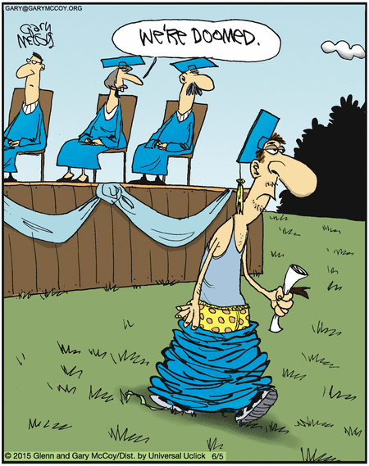
What stimuli are influencing this comment?
©
Notes:
Quick quiz – answer, likely dress – gown hanging down, shoelace untied, grey muscle shirt, facial expression; facial hair; posture.

Slide 13
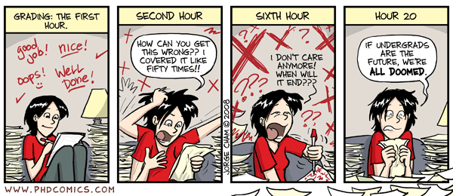
Norm-referencing bias & availability heuristic
© Jorge Cham, PHDCOMICS, 2019
Notes:
Norm-referencing bias (AAMC video calls this contrast effect) - comparing applicants to those coming before or after them.
Availability heuristic – placing more value on first idea that comes to mind (which may come to mind for a variety of reasons – the above as well as affective heuristic bias would be two common reasons).
From AAMC - Contrast effects: Comparing one applicant with the performance of previously interviewed applicants. The order in which the applicants are interviewed can affect the ratings they are given. While making ratings, interviewers should refrain from comparing applicants. Instead, interviewers should focus on evaluating each applicant’s response in relation to the rating scale.

Slide 14
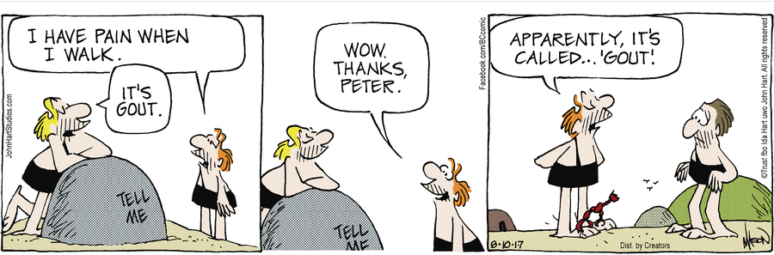
Anchoring
Reprinted by permission of John L. Hart FLP. © 8/10/2017
Notes:
Anchoring – overly influenced by an early piece of information (“first impression”). A failure to adjust initial prognoses on the basis of later information, or a failure to modify initial diagnoses because of new events.
Adame, B. J. (2016). Training in the mitigation of anchoring bias: A test of the consider-the-opposite strategy. Learning and Motivation, 53, 36-48.

Slide 15
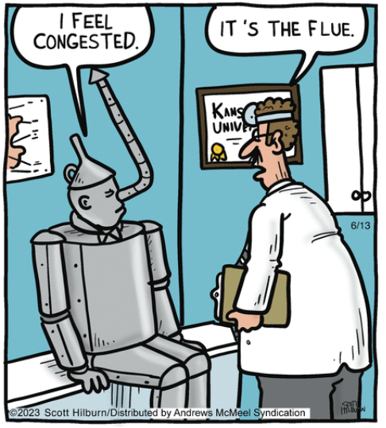
Premature closure
© Andrews McMeel Syndication; Argyle Sweater by Scott Hilburn; 6/13/2023
Notes:
Premature closure – impression formed early & we don’t adjust to new information.
Krupat, E., Wormwood, J., Schwartzstein, R. M., & Richards, J. B. (2017). Avoiding premature closure and reaching diagnostic accuracy: some key predictive factors. Medical Education, 51(11), 1127-1137. (also good for confirmation bias).

Slide 16
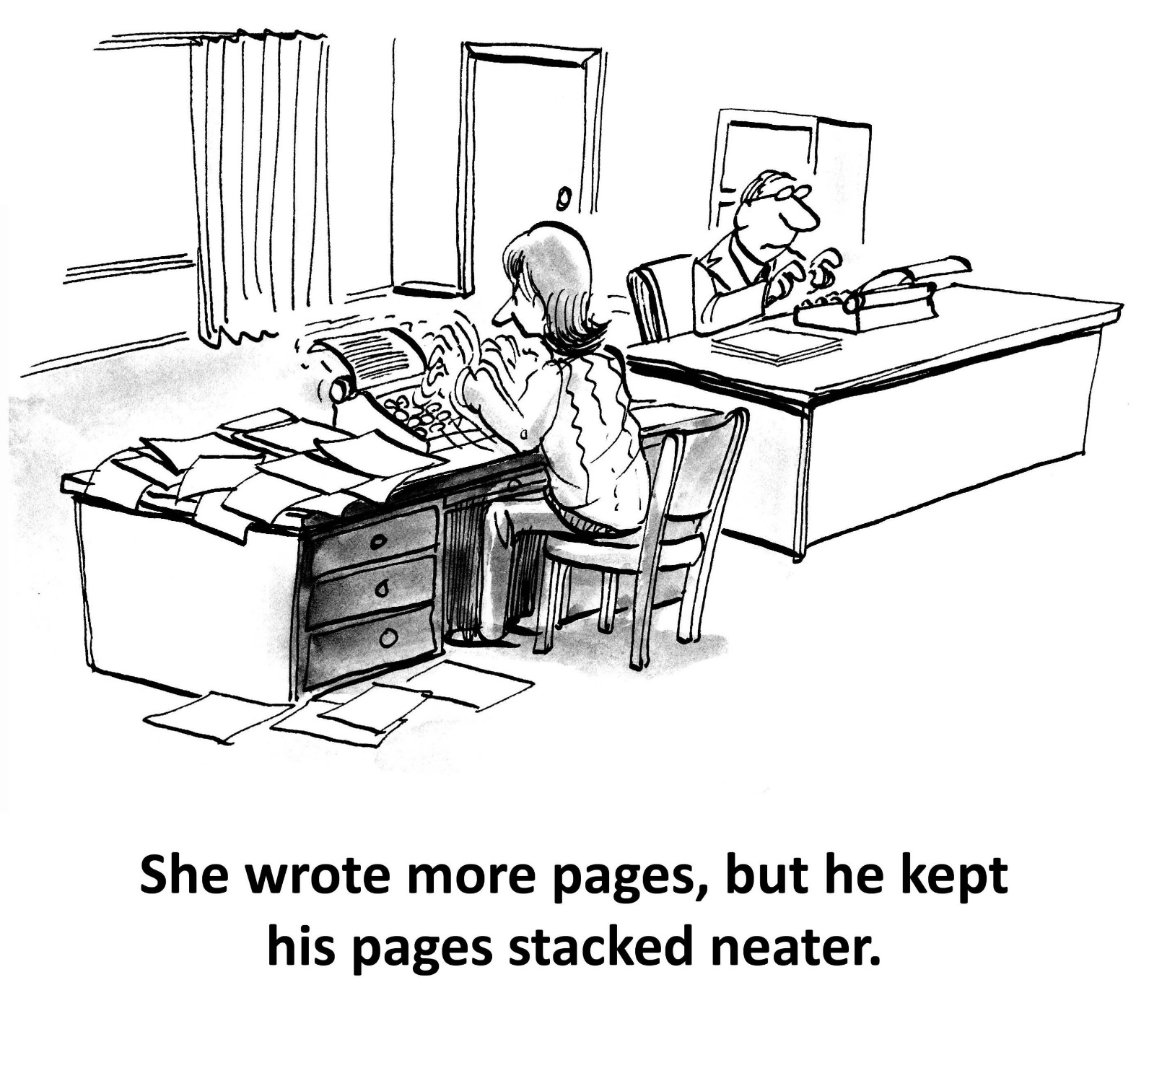
Halo & horns effect
© Shutterstock
Notes:
The feeling you get from some responses influences your perception of other responses. Importance of the first few minutes of an interview (“first impression”).
From AAMC - Halo/Horns effect: Allowing ratings of performance based on one response to influence ratings for another response. For example, allowing a rating on a question assessing teamwork to influence the rating on a question assessing motivation. Also similar to primacy/recency – using how you feel about a previous answer to influence the following answer.
MacDougall, M., Riley, S. C., Cameron, H. S., & McKinstry, B. (2008). Halos and Horns in the Assessment of Undergraduate Medical Students: A Consistency-Based Approach. Journal of applied quantitative methods, 3(2), 116-128.

Slide 17
Halo & horns effect
© Dean Young & John Marshall Blondie Comics 5/3/2022
Notes:
The feeling you get from some responses influences your perception of other responses. Importance of the first few minutes of an interview (“first impression”).
From AAMC - Halo/Horns effect: Allowing ratings of performance based on one response to influence ratings for another response. For example, allowing a rating on a question assessing teamwork to influence the rating on a question assessing motivation. Also similar to primacy/recency – using how you feel about a previous answer to influence the following answer.

Slide 18
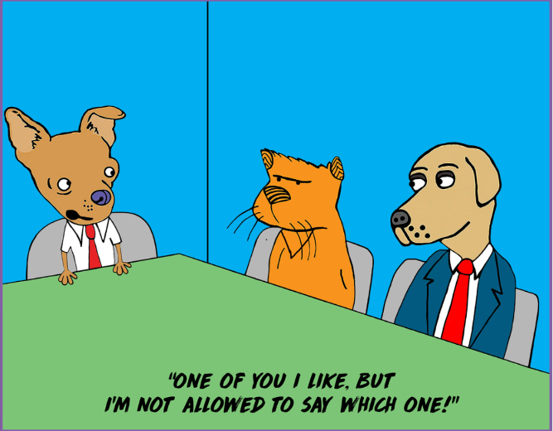
Affinity (similar-to-me) bias
© Shutterstock
Notes:
Favouring those who are more similar to ourselves (or to people we know & like). Common interests can be very influential.
Personal example from April, 2022; AJ Hinch, Detroit Tigers manager, decides to start the season with 3 catchers on the roster. It is rare – announcers thought it might be due to a bit of “catcher bias” since Hinch was a catcher when he played.
May, G. L. (2008). The effect of rater training on reducing social style bias in peer evaluation. Business Communication Quarterly, 71(3), 297-313. (also relevant to halo)

Slide 19
Confirmation bias
Dave Coverly; Speed Bump © 11/1/2020, Permission of Universal Uclick
Notes:
This bias can build on any of the previous ones – placing more value on information that supports your existing belief. We notice, remember, & interpret behaviour that reinforces our beliefs.

Slide 20
Strengths of groups
Variety of viewpoints
Larger pool of input
Discussion – assess evidence
Build on others
Detect bias in others
Notes:
Group decisions can overcome some individual bias but individuals bring their biases into the groups & group dynamics have unique biases as well.
Studies showing diagnosis accuracy improved via group decision compared with single-best individual.
Kurvers R, Herzog SM, Hertwig R, Krause J, Carney PA, Bogart A, Argenziano G, Zalaudek I, Wolf M. 2016 Boosting medical diagnostics by pooling independent judgments.Proc. Natl Acad. Sci. USA 113, 8777–8782. (doi:10.1073/pnas.1601827113)
Kurvers RHJM, Krause J, Argenziano G, Zalaudek I, Wolf M. 2015 Detection accuracy of collective intelligence assessments for skin cancer diagnosis. JAMA Dermatol.151, 1. (doi:10.1001/jamadermatol. 2015.3149)
Wolf M, Krause J, Carney PA, Bogart A, Kurvers RHJM. 2015 Collective intelligence meets medical decision-making: the collective outperforms the best radiologist.PLoS ONE 10, 1–10. (doi:10.1371/ journal.pone.0134269)

Slide 21
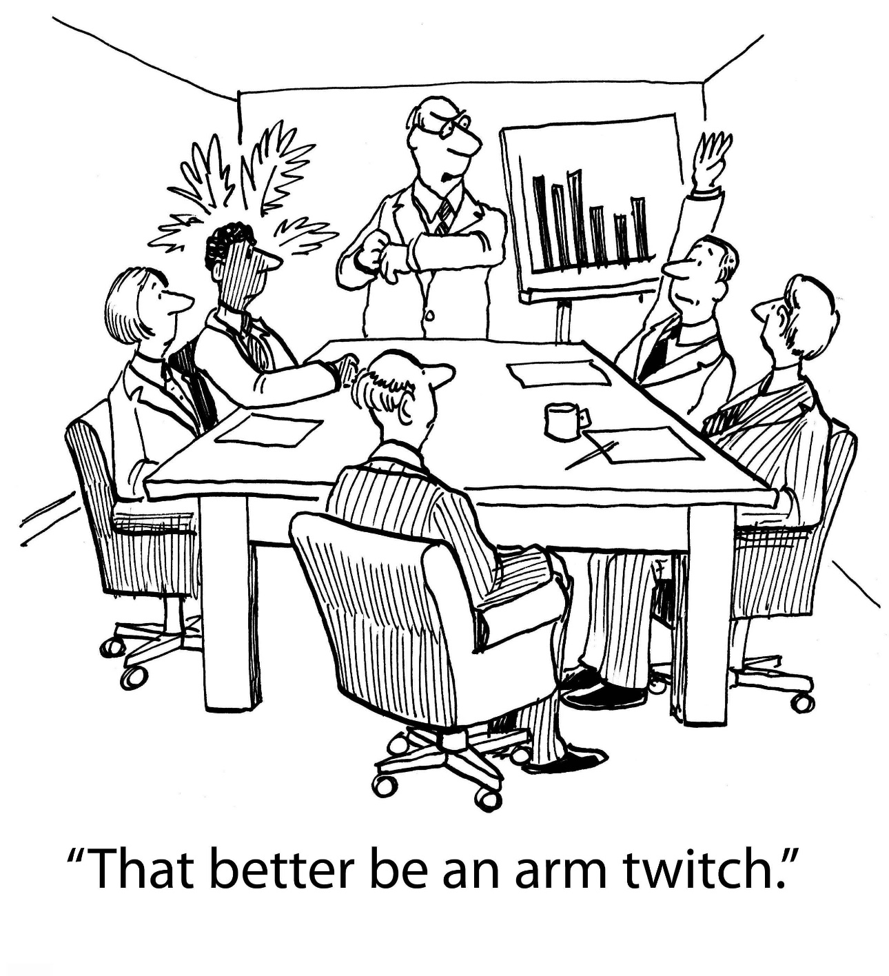
Group biases
Authority bias, bandwagon effect, groupthink, & status quo bias
© Shutterstock
Notes:
Many of these are related to psychological phenomena; we are driven by status, reputation, fitting in, etc.
Authority bias - declining to disagree with someone – likely due to power differential or persuasiveness. Thus the group decision can be swayed by one (or few) individual.
Bandwagon - believing things simply because others do.
Groupthink – striving for consensus, conformity, harmony – through socialization, individuals adapt to each other’s knowledge (i.e. the benefits of several independent ideas are lost). Can result from a desire to fit in or thinking someone else has better ideas/knowledge. Beliefs & behaviours can rapidly spread through a group.
Status quo bias - a preference for the current state of affairs. The current baseline (or status quo) is taken as a reference point.
For an example of this use the point of 25% plus applicant pool being female reduced/eliminated bias vs. women. Isaac, C., Lee, B., & Carnes, M. (2009). Interventions that affect gender bias in hiring: A systematic review. Academic medicine: journal of the Association of American Medical Colleges, 84(10), 1440.

Slide 22
I finally have a team that thinks like me
Shared information bias
© Lisa Kohn, Chatsworth Consulting Group, 2018
Notes:
Shared information bias – group members discussing information that they all have access to while ignoring equally important information that is available to only a few of the members.
Highlights need for diversity on teams. If members of a team have similar backgrounds &/or experiences, they may have similar ideas. For example, the inferences & assumptions they make may be the same. Individuals in these groups may also acquire new evidence in similar ways.
Kerr, N. L., & Tindale, R. S. (2004). Group performance and decision making. Annu. Rev. Psychol., 55, 623-655.

Slide 23
But does unconscious bias influence behaviour?
Voice inflection
Non-verbal communication (ex: eye contact, smiling, physical proximity, etc.)
Types of questions you ask
Types of comments you make
Demeanor
Time spent
Notes:
An example already used was the study (one of many) showing responses to email differed based on gender & ethnicity of the name.
Greenwald, A. G., & Banaji, M. R. (1995). Implicit social cognition: Attitudes, self-esteem, and stereotypes. Psychological Review, 102, 4–27. This study was the reason for creating the IAT – the knowledge that social behaviour often operates in unconscious fashion.
McConnell, A. R., & Leibold, J. M. (2001). Relations among the Implicit Association Test, discriminatory behavior, and explicit measures of racial attitudes. Journal of experimental Social psychology, 37(5), 435-442.
FitzGerald, C., & Hurst, S. (2017). Implicit bias in healthcare professionals: a systematic review. BMC medical ethics, 18(1), 19. More about patient-physician interactions & diagnostic decisions but easily transferrable to this context.
Elliott, A. M., Alexander, S. C., Mescher, C. A., Mohan, D., & Barnato, A. E. (2016). Differences in physicians' verbal and nonverbal communication with black and white patients at the end of life. Journal of pain and symptom management, 51(1), 1-8. In this small regional sample, hospital-based physicians have similar verbal communication behaviors when discussing end-of-life care for otherwise similar black and white patients but exhibit significantly fewer positive, rapport-building nonverbal cues with black patients (ex: distance from patient, open body language, touching patient).
Kang, J., Dasgupta, N., Yogeeswaran, K., & Blasi, G. (2010). Are ideal litigators white? Measuring the myth of colorblindness. Journal of Empirical Legal Studies, 7(4), 886-915. IAT & the connection to behavior.
Chen, M., & Bargh, J. A. (1997). Nonconscious behavioral confirmation processes: The self-fulfilling consequences of automatic stereotype activation. Journal of Experimental Social Psychology, 33(5), 541-560.
Fazio, R. H., Jackson, J. R., Dunton, B. C., & Williams, C. J. (1995). Variability in automatic activation as an unobtrusive measure of racial attitudes: A bona fide pipeline?. Journal of personality and social psychology, 69(6), 1013.
Stivers, T., & Majid, A. (2007). Questioning children: Interactional evidence of implicit bias in medical interviews. Social Psychology Quarterly, 70(4), 424-441.
Note Jerry Kang has a TED Talk (I have a screen shot in my bias resources) with a slide with several studies showing the link between implicit bias & behaviour.

Slide 24
Groups susceptible to bias?
Ethnic minorities, immigrants, the poor, low health-literacy individuals, sexual minorities, children/adolescents, women, the elderly, the mentally ill, the overweight, those with addiction issues, the disabled, etc.
Notes:
Before looking at the ways it may manifest in healthcare, let’s start by thinking about groups that may be susceptible. Brainstorm (or ask everyone to think of a few first), then give list.

Slide 25
b) Areas of healthcare
Public health messaging
Patient & colleague interactions
Diagnosis/treatment
Patient outcomes
Notes:
I will share one or two articles related to each of these.
A couple notes/caveats – the studies I’m sharing will focus on one specific type of negative implicit bias but any other implicit bias could theoretically be involved in having a similar effect. Secondly, these biases work both ways – i.e. physicians are on the receiving end of these experiences too. & a previous experience may bias a patient for their next one.

Slide 26
FitzGerald, C., & Hurst, S. (2017). Implicit bias in healthcare professionals: a systematic review. BMC medical ethics, 18(1), 19.
42 articles
Used IAT along with other implicit bias measures
Conclusion – implicit associations are widespread & can influence behaviour
Reminder – implicit biases are NOT equivalent to discrimination or racism
People with egalitarian beliefs still have implicit biases from internalizing cultural messaging
Notes:
This article is a good starting point – making connections between implicit bias & healthcare. Many of the groups noted on the previous slide.
Reminder that the IAT is not a metric of bias used to fix bias. It is a provocative trigger or consciousness raising tool. Other implicit bias measure (affective priming task, affective Simon task, the assumption method) were used in some of the studies - associations in terms of race, gender, ethnicity, nationality, sexual orientation, & weight.
Most studies found evidence of implicit bias among physicians & nurses; “The following characteristics are at issue: race/ethnicity, gender, socio-economic status (SES), age, mental illness, weight, having AIDS, brain injured patients perceived to have contributed to their injury, intravenous drug users, disability, and social circumstances.”
Ex: the studies we looked at in the first session regarding resumes/applications & names of different genders & ethnicities.
Note that this article uses the word “bias” more loosely & reflects the public’s common connections to the word as opposed to its actual true definition. Example – they say implicit associations lead to bias instead of equating them as they should be.
Our explicit beliefs don’t necessarily coincide with all of our implicit assumptions.

Slide 27
Stereotype perpetuated?
i. Public health messaging
Notes:
World AIDS day Dec. 1, 2020 ad from the Gov. of SK. They deleted it shortly after. Stereotype of HIV being a gay man’s disease.

Slide 28
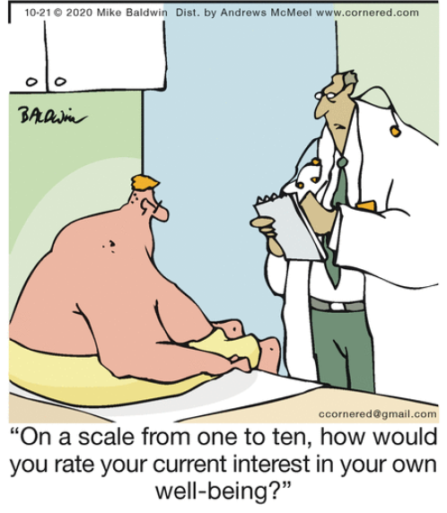
ii. Patient & colleague interactions
Mike Baldwin © 10/21/2020, Permission of Universal Uclick
Notes:
The interactions between multiple patient characteristics and between healthcare professional and patient characteristics reveal the complexity of the phenomenon of implicit bias and its influence on clinician-patient interaction.
Cartoon – doctor is making assumptions about the patient’s motivation (lazy etc.) based on body type. (also an example of microagressions – foreshadow).

Slide 29
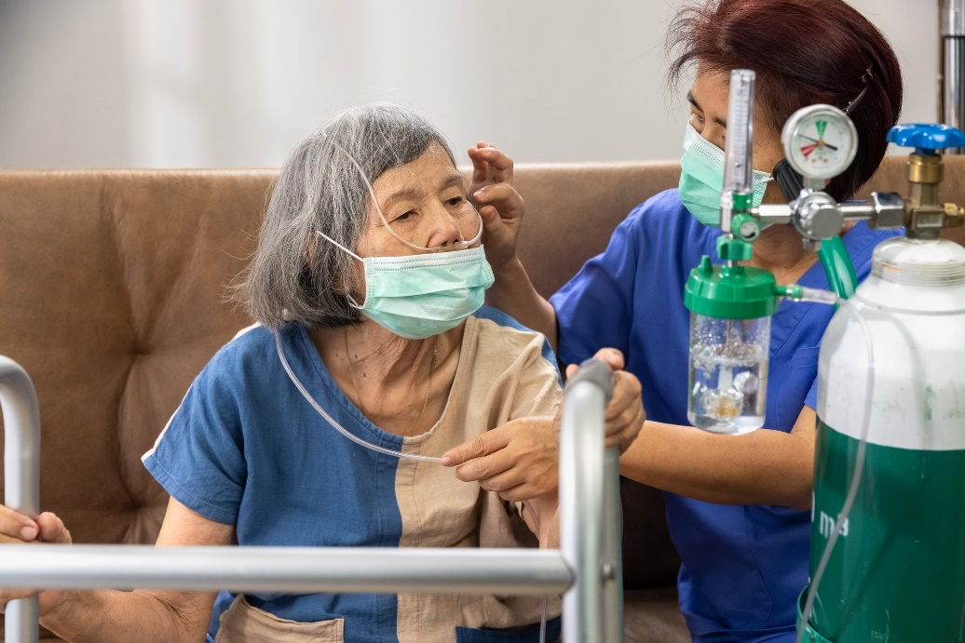
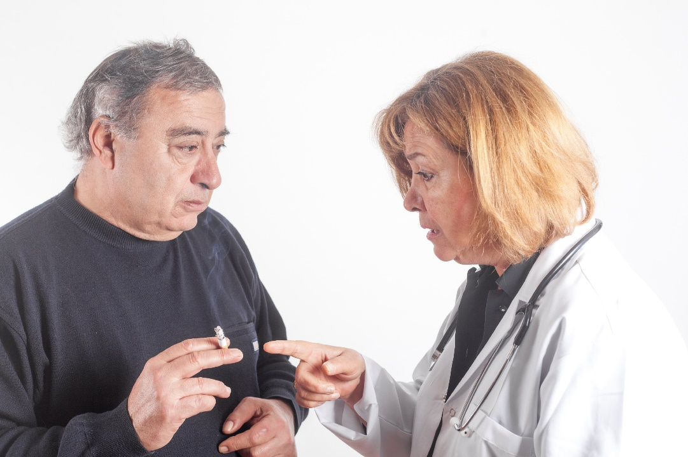
Unconscious bias & patients?
Notes:
Think about the patients you have & what unconscious biases might be involved – smokers, elderly, mental illness, indigenous, etc.
Ask them to think about the implications of social determinants of health & how it might be tied to unconscious bias.

Slide 30
Race/ethnicity; socio-economic status; substance use
Communication
Likelihood of seeking health care
Compliance with treatment
Tang, S. Y., & Browne, A. J. (2008). ‘Race’ matters: racialization and egalitarian discourses involving Aboriginal people in the Canadian health care context. Ethnicity and Health, 13(2), 109-127.
Notes:
The interactions between multiple patient characteristics and between healthcare professional and patient characteristics reveal the complexity of the phenomenon of implicit bias and its influence on clinician-patient interaction.
Evidence correlating implicit bias with negative effects on clinical interactions is clearer/stronger than the evidence for connecting it to treatment outcomes. However, due to the importance of the relationship between healthcare provider & patient, it is difficult to imagine this would not be the result.
Explicitly, “we treat all patients the same” – yet many patients do not feel like they are being treated fairly or the same.
An American study which is similar but goes into implicit bias a bit more:
Cooper, L. A., Roter, D. L., Carson, K. A., Beach, M. C., Sabin, J. A., Greenwald, A. G., & Inui, T. S. (2012). The associations of clinicians’ implicit attitudes about race with medical visit communication and patient ratings of interpersonal care. American journal of public health, 102(5), 979-987. Clinician implicit race bias and race and compliance stereotyping are associated with markers of poor visit communication and poor ratings of care, particularly among Black patients.

Slide 31
Black patients in U.S.
Interaction length
Trust in physician
Patient involvement in treatment decisions
Verbal dominance
Penner, L. A., Dovidio, J. F., Gonzalez, R., Albrecht, T. L., Chapman, R., Foster, T., ... & Eggly, S. (2016). The effects of oncologist implicit racial bias in racially discordant oncology interactions. Journal of clinical oncology, 34(24), 2874.
Notes:
The interactions between multiple patient characteristics and between healthcare professional and patient characteristics reveal the complexity of the phenomenon of implicit bias and its influence on clinician-patient interaction.
Evidence correlating implicit bias with negative effects on clinical interactions is clearer/stronger than the evidence for connecting it to treatment outcomes. However, due to the importance of the relationship between healthcare provider & patient, it is difficult to imagine this would not be the result.
Explicitly, “we treat all patients the same” – yet many patients do not feel like they are being treated fairly or the same.
An American study which is similar but goes into implicit bias a bit more:
Cooper, L. A., Roter, D. L., Carson, K. A., Beach, M. C., Sabin, J. A., Greenwald, A. G., & Inui, T. S. (2012). The associations of clinicians’ implicit attitudes about race with medical visit communication and patient ratings of interpersonal care. American journal of public health, 102(5), 979-987. Clinician implicit race bias and race and compliance stereotyping are associated with markers of poor visit communication and poor ratings of care, particularly among Black patients.

Slide 32
Racial/ethnic minorities
Believe race negatively affects their health care
Less trusting of healthcare system
Reduced use of healthcare services
Lower levels of medical adherence
Dovidio, J. F., & Fiske, S. T. (2012). Under the radar: how unexamined biases in decision-making processes in clinical interactions can contribute to health care disparities. American journal of public health, 102(5), 945-952.

Slide 33
Nonverbal communication
Physicians had similar verbal communication behaviours but fewer positive, rapport-building nonverbal cues with black patients
Elliott, A. M., Alexander, S. C., Mescher, C. A., Mohan, D., & Barnato, A. E. (2016). Differences in physicians' verbal and nonverbal communication with black and white patients at the end of life. Journal of pain and symptom management, 51(1), 1-8.
Notes:
In this small regional sample, hospital-based physicians have similar verbal communication behaviors when discussing end-of-life care for otherwise similar black and white patients but exhibit significantly fewer positive, rapport-building nonverbal cues with black patients (ex: distance from patient, open body language, touching patient).
Note Penner study in the slide above which also has a non-verbal component – interaction length.

Slide 34
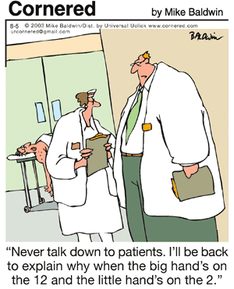
Colleague interactions
Wellness of healthcare professionals
Mike Baldwin © 8/5/2003, Permission of Universal Uclick

Slide 35
Internal Medicine grand rounds
Men introduced women less frequently with a professional title
Amplify isolation
Marginalization
Gender stereotype perpetuation
Files, J. A., Mayer, A. P., Ko, M. G., Friedrich, P., Jenkins, M., Bryan, M. J., ... & Hayes, S. N. (2017). Speaker introductions at internal medicine grand rounds: forms of address reveal gender bias. Journal of women's health, 26(5), 413-419.
Notes:
Study done in 2 locations – Arizona & Minnesota. Women introduced nearly all speakers with “Dr.”. Men introducing women with “Dr.” was about 50/50.

Slide 36
Microaggressions “micro” in frequency, not impact
A comment or action that subtly and often unconsciously or unintentionally expresses a prejudiced attitude toward a member of a marginalized group
“Microaggressions can be delivered as a compliment but contain a meta-communication or hidden insult … they occur because they are outside the level of conscious awareness of the perpetrator” – Dr. Derald Wing Sue.
Notes:
We don’t have time to do this justice but I want them to think about it (last session of this day is from Dr. Anita Chakravarti on “staff resilience” so this is related).
It’s okay to say the wrong thing – it happens. Listen to how others perceive communication & avoid defensiveness. Apologize & try not to do it again.
Sue, D. W., Capodilupo, C. M., Torino, G. C., Bucceri, J. M., Holder, A., Nadal, K. L., & Esquilin, M. (2007). Racial microaggressions in everyday life: Implications for clinical practice. American psychologist, 62(4), 271.

Slide 37
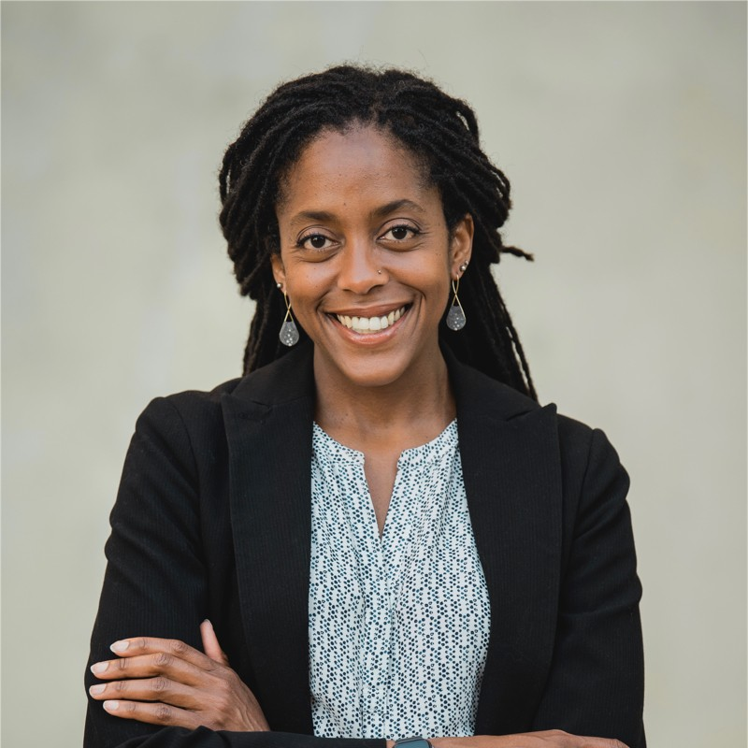
Dr. Khama Ennis video
Image used with permission from Dr. Khama Ennis 4/27/2022
“Imagine how it feels to drink sips of poison every single day”
I See Color (9 min. video)
Notes:
Ask them to watch this 9 minute video. I See Color. https://www.youtube.com/watch?v=hQY2th12qaI

Slide 38
Example
Canadian doctors discuss their experiences of systemic racism
https://www.cbc.ca/player/play/1751891523593
Notes:
https://www.cbc.ca/player/play/1751891523593 has just the video clip (cannot embed this one as it is CBC video.
https://www.cbc.ca/news/health/racism-canadian-medicine-doctors-1.5615554 - full article with a few videos
Show the 1:19 clip of Dr. Nel Wieman to illustrate microagressions from colleagues (she is Indigenous). It is the 2nd video down the page. Suggest to read article &/or watch the clips of the other 4 doctors.

Slide 39
iii. Diagnosis/treatment
Connection between unconscious bias & pain assessment in Indigenous patients in U.S.
Johnson-Jennings, M., Tarraf, W., & González, H. M. (2015). The healing relationship in Indigenous patients' pain care: Influences of racial concordance and patient ethnic salience on healthcare providers' pain assessment. International Journal of Indigenous Health, 10(2), 33-50.
Notes:
Pain assessment with Indigenous patients (U.S.) likely influenced by implicit bias.
Many other examples of similar phenomenon.

Slide 40
Diagnosis/treatment
Connection between unconscious bias & pain prescriptions/management in Pediatrics
Sabin, J. A., & Greenwald, A. G. (2012). The influence of implicit bias on treatment recommendations for 4 common pediatric conditions: pain, urinary tract infection, attention deficit hyperactivity disorder, and asthma. American journal of public health, 102(5), 988-995.
Notes:
Pediatricians' implicit (unconscious) attitudes and stereotypes were associated with treatment recommendations. The association between unconscious bias and patient's race was statistically significant for prescribing a narcotic medication for pain following surgery. As pediatricians' implicit pro-White bias increased, prescribing narcotic medication decreased for African American patients but not for the White patients. Self-reported attitudes about race were associated with some treatment recommendations.
Conclusions: Pediatricians' implicit attitudes about race affect pain management. There is a need to better understand the influence of physicians' unconscious beliefs about race on pain and other areas of care.
Another example
Green, A. R., Carney, D. R., Pallin, D. J., Ngo, L. H., Raymond, K. L., Iezzoni, L. I., et al. (2007). Implicit bias among physicians and its prediction of thrombolysis decisions for black and white patients. Journal of General Internal Medicine, 22(9), 1231–1238.

Slide 41
Diagnosis/treatment
Women are three-times less likely to be referred for total knee replacement than men even when clinically indicated, & are less likely to be diagnosed with COPD than men despite having similar histories and medical examinations
Chapman, E. N., Kaatz, A., & Carnes, M. (2013). Physicians and implicit bias: how doctors may unwittingly perpetuate health care disparities. Journal of general internal medicine, 28(11), 1504-1510.
Notes:
Also this study re: the content of this slide; Chapman, K. R., Tashkin, D. P., & Pye, D. J. (2001). Gender bias in the diagnosis of COPD. Chest, 119(6), 1691-1695.
Also; Strek, M. E. (2020). Gender in idiopathic pulmonary fibrosis diagnosis: time to address unconscious bias. “More recently, the stereotype of the male smoker with lung cancer has been upended by the surprising data demonstrating higher lung cancer incidence rates in young women as compared with young men, not explained by differences in cigarette smoking. there is evidence for bias when using sex to inform an ILD (interstitial lung disease) diagnosis, which may result in men being overdiagnosed and women underdiagnosed with IPF (idiopathic pulmonary fibrosis).” This potential gender bias was shared by both female & male physicians. “The study raises interesting questions about the cultural and learnt beliefs or biases we bring to the diagnosis and treatment of illness. Failure to consider group differences confounds our efforts to achieve an accurate diagnosis and prescribe optimal therapy. A study of patient gender disparities in survival rates following acute myocardial infarction, based on the gender of the treating physician, showed a higher mortality among female patients treated by male physicians that was mitigated by increased male physician exposure to female patients and to female physician colleagues. This suggests that greater diversity in clinical and investigative teams improves patient outcomes and could address the potential for gender to confound diagnostic accuracy noted by the authors in this study

Slide 42
Diagnosis/treatment
3 studies re: elderly – differences in therapy recommendation, aggressiveness of treatment, & optimism about outcomes
Chapman, E. N., Kaatz, A., & Carnes, M. (2013). Physicians and implicit bias: how doctors may unwittingly perpetuate health care disparities. Journal of general internal medicine, 28(11), 1504-1510.
Notes:
Chapman was a systematic review so they looked at many studies.

Slide 43
iv. Patient health outcomes
Unconscious bias connected to poorer psychosocial outcomes based on race/ethnicity (depression, life satisfaction, social integration)
Hausmann, L. R., Myaskovsky, L., Niyonkuru, C., Oyster, M. L., Switzer, G. E., Burkitt, K. H., ... & Boninger, M. L. (2015). Examining implicit bias of physicians who care for individuals with spinal cord injury: A pilot study and future directions. The journal of spinal cord medicine, 38(1), 102-110.
Notes:
The study of physicians specializing in spinal cord injury found significant relations between implicit bias scores and patient health outcomes. Psychosocial health outcomes (i.e., social integration, depression, and life satisfaction) for Black and White patients appeared to be negatively affected by the presence of physician bias in this sample.
This pilot study indicates that SCI providers are susceptible to implicit racial bias and provides preliminary evidence that greater implicit racial bias of physicians is associated with poorer psychosocial health outcomes for individuals with SCI.

Slide 44
“… biased social lens through which Brian Sinclair was viewed … vision of those caring for this man was obfuscated by the stereotypes built within the system & throughout Canadian society.”
Brian Sinclair photo courtesy CBC News
Gunn, B. L. Ignored to death: Systemic racism in the Canadian healthcare system. Submission to EMRIP the Study on Health, United Nations.
Notes:
“It was the biased social lens through which Brian Sinclair was viewed. The vision of those charged with caring for this man was obfuscated by the stereotypes built within the system and throughout Canadian society.”
“The disconnect represented in the media showing large federal investments and poorer health perpetuates assumptions that the lower health outcomes of Indigenous people is their fault, and validates erroneous, biased assumptions that it is acceptable to offer up a reduced level of care.”
Brian Sinclair, an Indigenous man from Manitoba in central Canada, died in the emergency department of Winnipeg’s Health Sciences Centre (HSC) in September 2008. He was 45 years old. He had sought care from a family physician at a primary care clinic. The physician referred him to the emergency department of HSC located just a few blocks away for further care. Brian Sinclair was sent by taxi to HSC. In his wheelchair, he entered the emergency department of the most comprehensive hospital in Manitoba. After being ignored, unattended, and uncared for during the next thirty-four hours, he died of complications of a treatable bladder infection.

Slide 45
Real impacts
Brian Sinclair photo courtesy CBC News
“…We need to understand that the perceptions we have, the assumptions we make about people all impact about how we deliver care to individuals…”
Réal Cloutier, interim president of the Winnipeg Regional Health Authority
Notes:
Brian Sinclair, an Indigenous man from Manitoba in central Canada, died in the emergency department of Winnipeg’s Health Sciences Centre (HSC) in September 2008. He was 45 years old. He had sought care from a family physician at a primary care clinic. The physician referred him to the emergency department of HSC located just a few blocks away for further care. Brian Sinclair was sent by taxi to HSC. In his wheelchair, he entered the emergency department of the most comprehensive hospital in Manitoba. After being ignored, unattended, and uncared for during the next thirty-four hours, he died of complications of a treatable bladder infection.

Slide 46
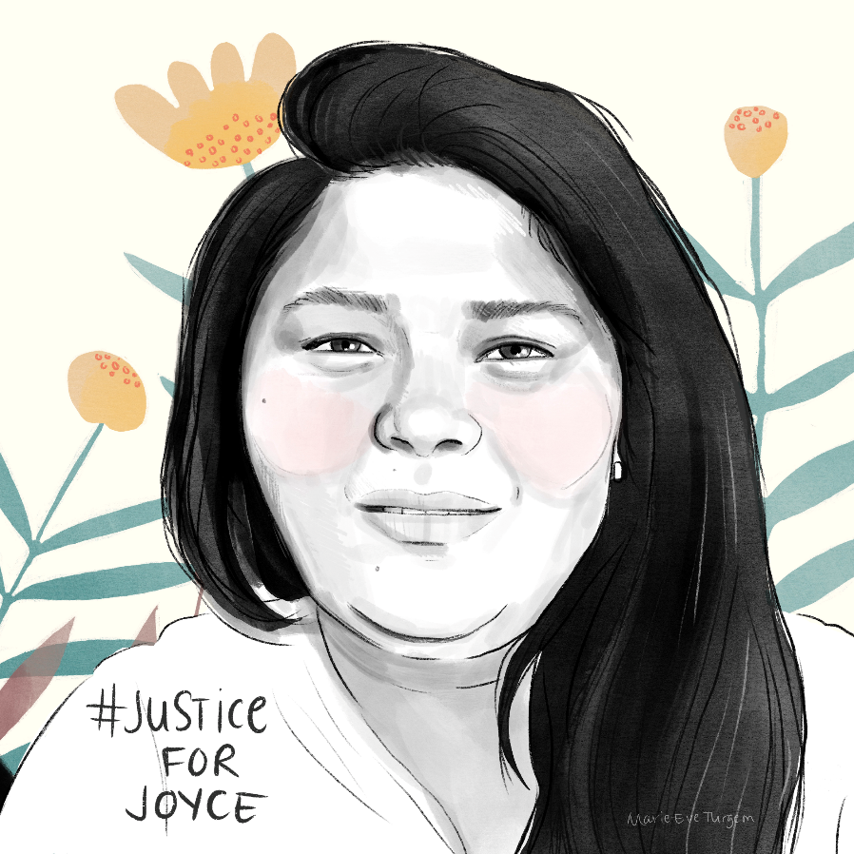
Joyce Echaquan
“A Quebec coroner's report concluded Friday that the racism and prejudice Joyce Echaquan faced in the hospital contributed to her death last year. The report went on to say that Quebec must acknowledge systemic racism within its institutions.” CBC; October 1, 2021
Created by, & permission from, Marie-Eve Turgeon
Permission Alice Echaquan, via Wikimedia Commons
Notes:
https://www.cbc.ca/news/canada/montreal/joyce-echaquan-systemic-racism-quebec-government-1.6196038
Atikamekw woman died of pulmonary edema (excess fluid in the lungs) last September and was subject to racist remarks by hospital staff. Echaquan, a mother of seven, died on Sept. 28, 2020, at a hospital north of Montreal (Joliette, Que.), moments after she recorded footage of herself in hospital as health-care staff hurled racist remarks at her. Géhane ​Kamel's report notes that Echaquan's care was affected because medical staff assumed she was suffering from withdrawal.
The gastroenterologist who first saw Echaquan the day before her death suggested the theory, which led him to postpone her colonoscopy exam to the next day.
Other health-care workers also treated her based on that idea, even though there was no evidence to back it up.
Kamel wrote in the report that the assumption that Echaquan was addicted to drugs was unfounded.
At the hospital, when Echaquan became agitated and complained of heart palpitations, she was given sedatives and no further tests were done.
Given her medical history — Echaquan had diabetes and cardiomyopathy — Kamel writes that those palpitations should have raised some red flags among health-care staff.
The medical expert who spoke during the inquiry, Dr. Alain Vadeboncoeur, said being held in restraints may have worsened her condition because she was lying down, and the liquid kept accumulating.
Kamel said if Echaquan had been treated differently, her death could have been prevented.
"When the system [gets defensive], it is the very definition of systemic racism."

Slide 47
Small group discussion
Examples of unconscious bias
What were the results?
Any strategies used?
Other strategies that could have been used?

Slide 48
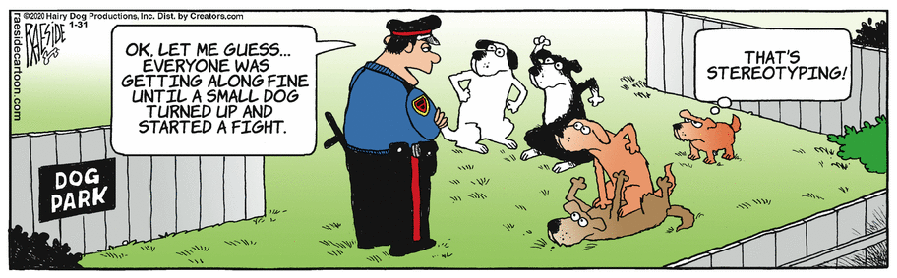
2) Strategies
Goal is to improve decision-making, communication, & relationships
The Other Coast by Adrian Raeside © 1/31/2020, Permission of Universal Uclick
Notes:
See implicit bias in the toolkit for teaching about racism

Slide 49
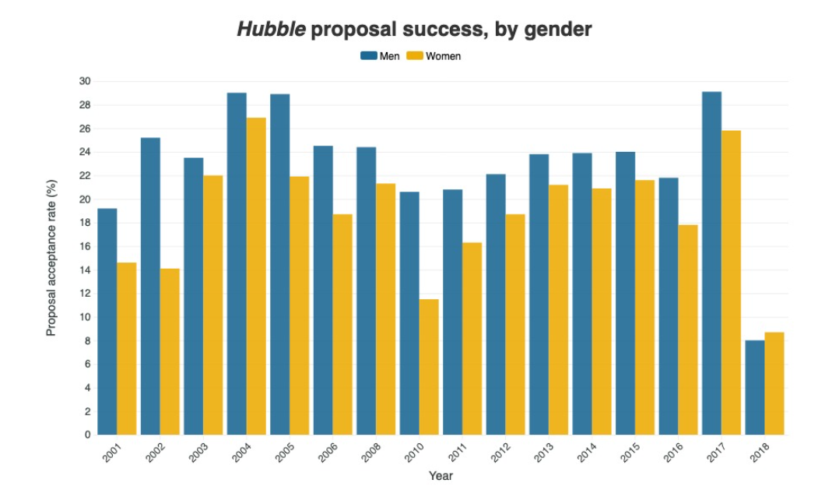
Policy level
Strolger, L., & Natarajan, P. (2019). Doling out Hubble time with dual-anonymous evaluation. Physics Today.
Notes:
Ask them to guess what happened in 2018. From 2001 to 2017 Hubble observing proposals led by men (blue) had better success rates than those led by women (yellow). 2018 a dual-anonymous, double blind review system was implemented. No time was allocated in 2007 & 2009.
NASA now addressing gender, ethnic, & institution (those from small research institutions) bias.
Just 1 quick example of unconscious bias & how it can be reduced at the policy level. At this stage in their careers, this won’t be as relevant, but they can start looking for ways to reduce the possibility of bias in systems.

Slide 50
Policy level medicine
No statistically significant disparities in tests ordered for patients diagnosed with head injury when using the CHALICE (Children’s Head injury Algorithm for the prediction of Important Clinical Events)
Dunning, J., Daly, J. P., Lomas, J. P., Lecky, F., Batchelor, J., & Mackway-Jones, K. (2006). Derivation of the children’s head injury algorithm for the prediction of important clinical events decision rule for head injury in children. Archives of disease in childhood, 91(11), 885-891.
Notes:
Example from Pediatrics. Using a clinical algorithm can reduce the impact of bias &, thus, health disparities.
This is despite other studies that show disparities in tests ordered based on socio-economic status & race/ethnicity.

Slide 51
Policy level
Standardization – (ex: structured interviews)
Training for consistency
Clearly defining criteria & scoring rubrics
Shared decision-making (ex: fixed “floor” time)
Opinion anonymity &/or devil’s advocate
Revisit assumptions
Diversity – input from everyone
Notes:
“The MMI interview style has gained support as studies have demonstrated that performance does not seem to be impacted by gender, family income level, size of community of origin, or ethnicity.” From - Girgulis, K., Rideout, A., & Rashid, M. (2019). Performance of Black and Indigenous applicants in a medical school admissions process. Canadian Medical Education Journal. The citation for this comment is the article below.
Jerant A, Fancher T, Fenton JJ, et al. How medical school applicant race, ethnicity, and socioeconomic status relate to multiple mini-interview-based admissions outcomes: findings from one medical school. Acad Med. 2015;90(12):1667-1674.
Re: Devil’s advocate position - Lord, C. G., Lepper, M. R., & Preston, E. (1984). Considering the opposite: a corrective strategy for social judgment. Journal of personality and social psychology, 47(6), 1231. Proven effective strategy to reduce bias.
Blatt, B., LeLacheur, S. F., Galinsky, A. D., Simmens, S. J., & Greenberg, L. (2010). Does perspective-taking increase patient satisfaction in medical encounters?. Academic Medicine, 85(9), 1445-1452. “Student–clinicians who were given a perspective-taking intervention received significantly better patient satisfaction scores from SPs than did controls.”

Slide 52
Individual level
Accept & acknowledge bias
Situational awareness
Identifying when bias is most relevant
Explore & examine the nature of the bias (assumptions)
Consider alternatives & multiple perspectives & sources
Interruption not elimination
Notes:
Reminder of strategies from the 1st session.
Mitigation, not elimination.
Thinking strategy.
We will add to the strategies here – especially awareness & seeking different possibilities & perspectives.
Psychologist Jennifer Eberhardt, among others, states that a primary countermeasure is to slow down, to move your thinking from the primitive, reactive parts of the brain to more reflective levels. Dealing with bias is a personal enterprise of pausing and examining one’s assumptions. “We could practice adding friction to our own lives,” Eberhardt says, “by interrogating ourselves and slowing ourselves down … just being aware when we’re beginning to make stereotypic associations.” As she concludes in her book, “There is hope in the sheer act of reflection. This is where the power lies and how the process starts.”
Verna Myers (TED talk) also makes this point – we need to eliminate the moral attachment to bias – it liberates us to move beyond denial.
Mention the IAT (in case anyone went online & did any of the tests) as an example of bringing unconscious biases (associations) to conscious awareness.
Conscious mind needs to interrupt the unconscious.
Awareness alone can mitigate bias – NBA referee study (mentioned in the first study).

Slide 53
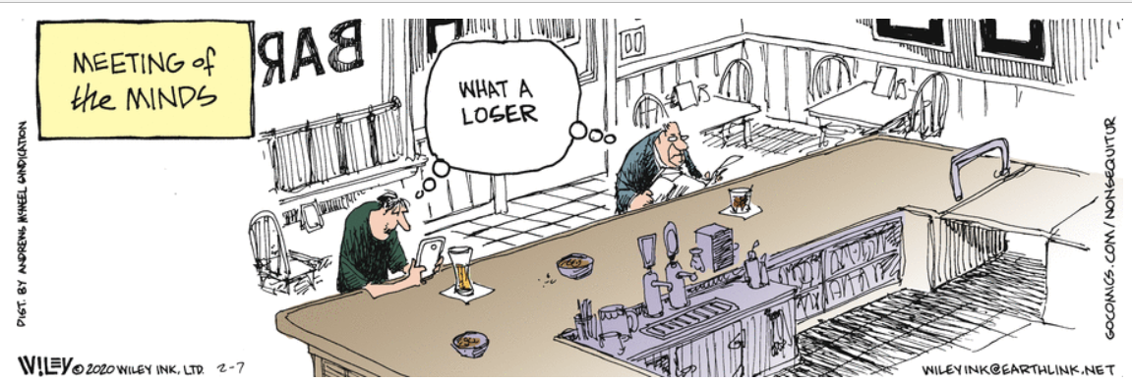
Improve outcomes with individuation
Our brains default to categorization
We need to search for individuating information
Wiley Miller Inc. Ltd. © 2/7/2020, Permission of Universal Uclick
Notes:
We have a natural tendency to categorize things, including people.
With every categorization, we make many associations.
We make associations automatically for ease of problem solving. Dangerous to do with patients to apply any group-level stereotype to them.

Slide 54
Tips
Conversation is key
Avoid misunderstandings & assumptions
Listen thoughtfully
Be humble, be curious; ask questions & acknowledge mistakes
Avoid judgmental reactions & language
& avoid speculating on intent
Notes:
Quote from video with Jerry Kang, Vice Chancellor of Equity, Diversity and Inclusion at UCLA – discussing the IAT & unconscious bias (https://www.youtube.com/watch?v=w0YvI1gDKEI).

Slide 55
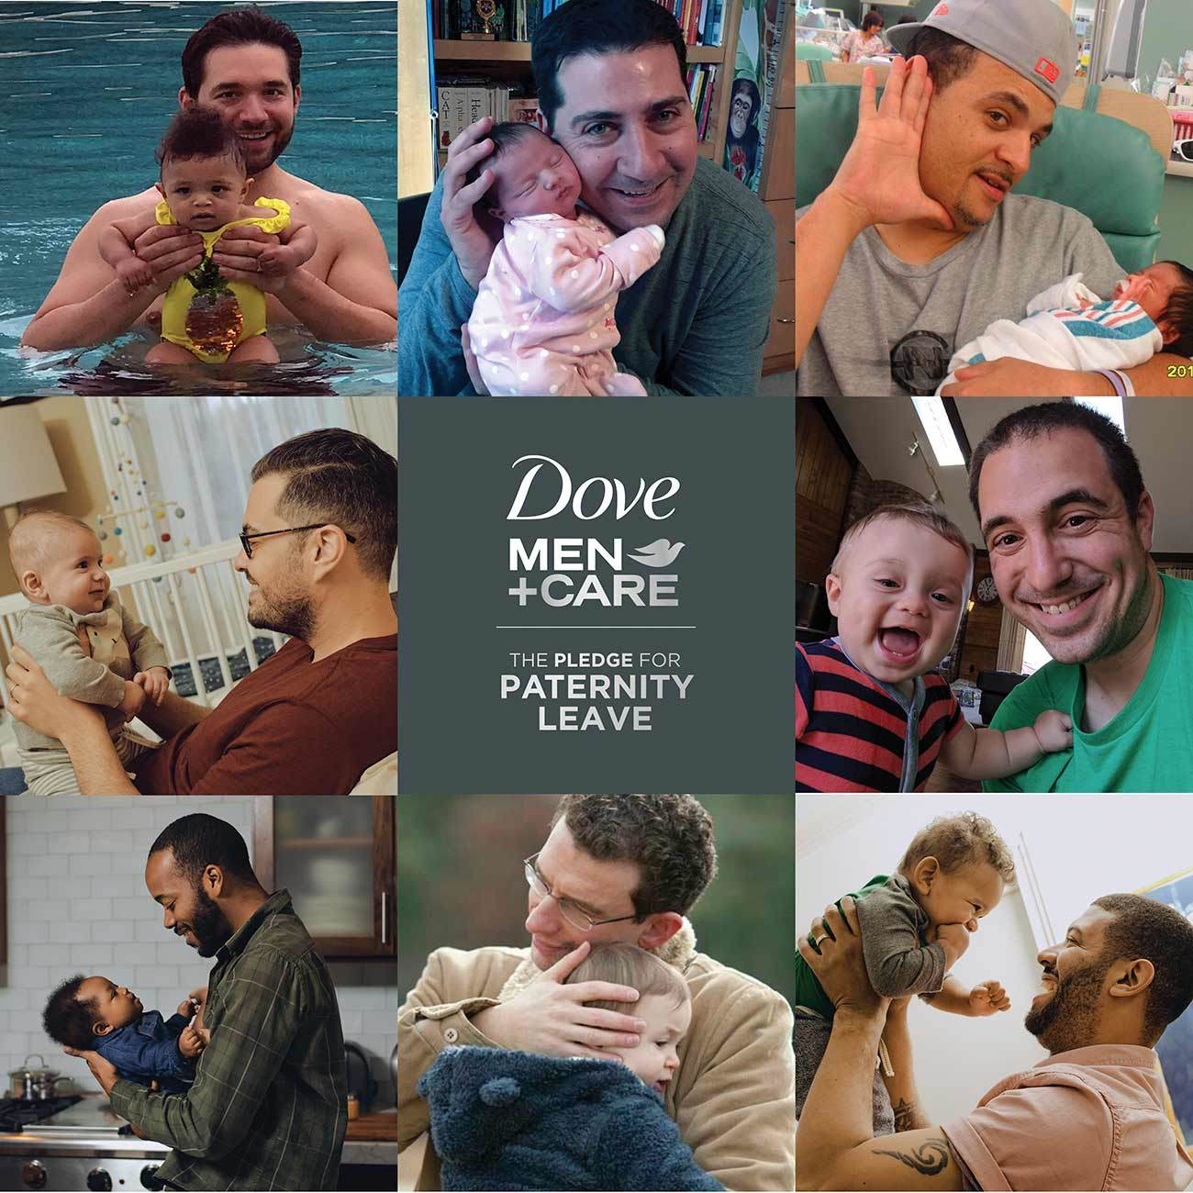
Use counter-stereotypes
Images © Dove.com
The Look – Procter & Gamble
“Traits exhibited in group members that are inconsistent with or contrary to stereotypes”
Notes:
Definition is from - Chen, L., Zhang, X., Fan, S., Fu, L., & Zhao, J. (2021). Effects of Counter-Stereotypes Cognitive Training on Aging Stereotypes in 12–to 13-Year Olds. Frontiers in Psychology, 4525.
Also considering the opposite & perspective-taking.
The UK, realizing the harmful effects of perpetuating gender stereotypes in advertising, has banned (2019) commercials it deems sexist, including Volkswagen & Philadelphia Cream Cheese. The new rules, introduced at the beginning of the year, ban the depiction of men and women engaged in gender-stereotypical activities to help stop “limiting how people see themselves and how others see them and the life decisions they take”.
Canada has guidelines for this too. Belgium, France, Finland, Greece, India, Norway and South Africa also have rules on gender stereotypes in advertising.
https://nationalpost.com/news/world/philadelphia-cream-cheese-and-volkswagen-ads-axed-due-to-harmful-gender-stereotyping
UK full report on gender stereotypes in advertising – Depictions, Perceptions & Harm; https://www.asa.org.uk/static/uploaded/e06425f9-2f9f-44c3-ae6ebd5902686d44.pdf
https://www.youtube.com/watch?v=aC7lbdD1hq0 (1:43) – The Look – Procter & Gamble. Our biases do not make us bad people; they reflect the culture we live in. Challenge these when possible.
Clip really shows how implicit bias can manifest in non-verbal behaviour like eye contact & body language.
The end of the scene is an example of counter-stereotyping.
Lord, C. G., Lepper, M. R., & Preston, E. (1984). Considering the opposite: a corrective strategy for social judgment. Journal of personality and social psychology, 47(6), 1231. Proven effective strategy to reduce bias.
Blatt, B., LeLacheur, S. F., Galinsky, A. D., Simmens, S. J., & Greenberg, L. (2010). Does perspective-taking increase patient satisfaction in medical encounters?. Academic Medicine, 85(9), 1445-1452. “Student–clinicians who were given a perspective-taking intervention received significantly better patient satisfaction scores from SPs than did controls.”
Cuddy, A. J., Wolf, E. B., Glick, P., Crotty, S., Chong, J., & Norton, M. I. (2015). Men as cultural ideals: Cultural values moderate gender stereotype content. Journal of personality and social psychology, 109(4), 622.

Slide 56
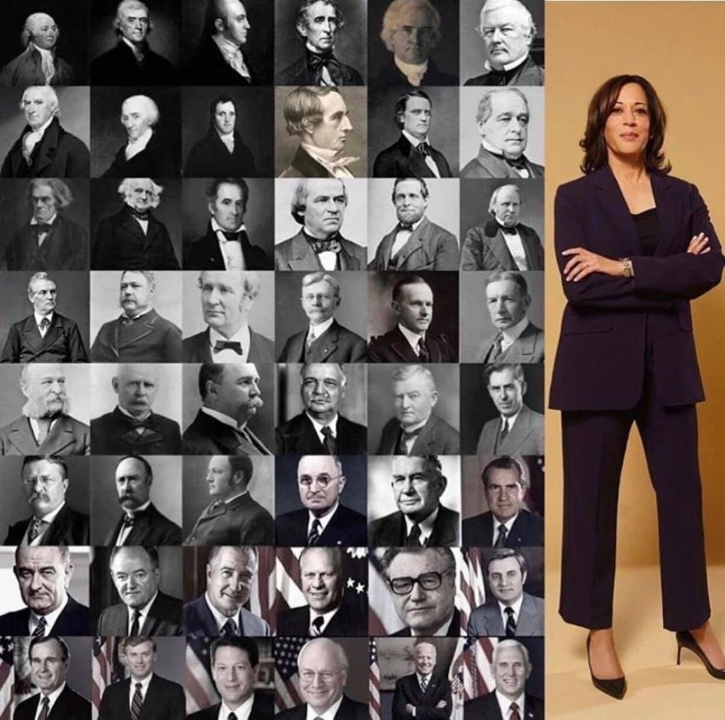
Politics & leadership
Image courtesy isaboutto on imgur
Notes:
Counter-stereotyping can be very powerful. Kamala Harris Vice President.
Remind them of the surgeon riddle we looked at in the 1st session.

Slide 57
Theatre
Image courtesy Ken Lund; flickr; July 11, 2018

Slide 58
Comic counter-stereotype - explicit
Wiley Miller Inc. Ltd. © 6/25/2020, Permission of Universal Uclick
Notes:
Note in the 1st session we looked at comics that reinforce stereotypes.

Slide 59
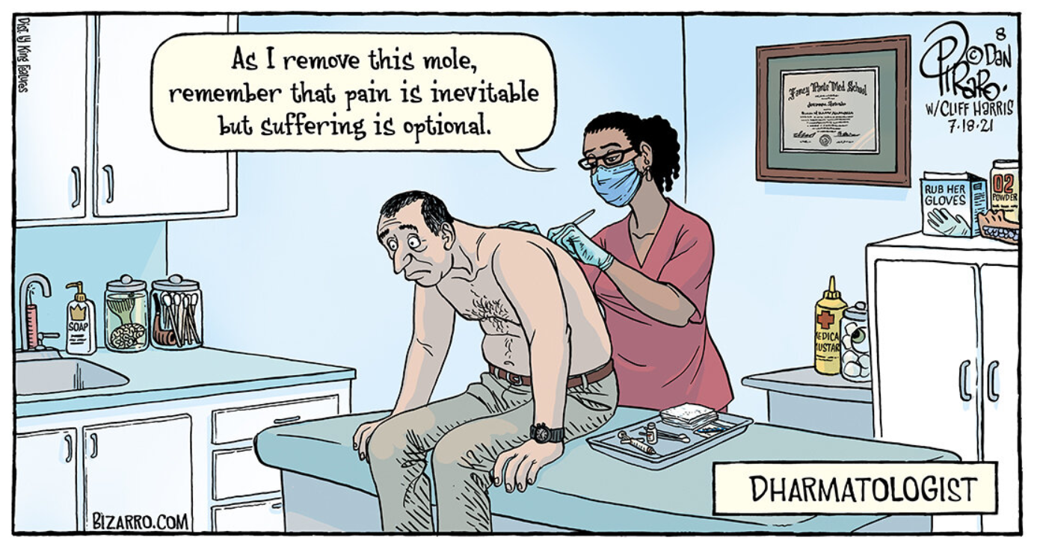
Counter-stereotype - implicit
©
Notes:
Refer back to the surgeon riddle – again, what we say/do may not align with our held beliefs. Dharma is the Buddhist doctrine of universal truth.
Apologize, commit to doing better next time, & move on. Use the cartoon as an example of doing this.

Slide 60
“… addressing & curtailing implicit biases is a necessity to preserve provider resiliency while providing high-value, patient-centered care.”

Slide 61
Cultural humility involves …
“A lifelong commitment to self-evaluation & self-critique in an effort to address power imbalances & to advocate for others.”
Mitigate implicit bias
Promote empathy
Acknowledge & respect patient individuality
Masters, C., Robinson, D., Faulkner, S., Patterson, E., McIlraith, T., & Ansari, A. (2019). Addressing biases in patient care with the 5Rs of cultural humility, a clinician coaching tool. Journal of General Internal Medicine, 34, 627-630. P. 627.
Notes:
From the article – emphasizes provider’s need to connect instead of being an expert on the patient’s race, culture, or ethnicity.

Slide 62
The 5 Rs of cultural humility
“… to bring more awareness into clinical encounters in an attempt to improve health care by decreasing disparities, improving the patient-clinician relationship, highlighting shared humanity, & building provider resilience.”
Reflection; Respect; Regard; Relevance; & Resiliency
Masters, C., Robinson, D., Faulkner, S., Patterson, E., McIlraith, T., & Ansari, A. (2019). Addressing biases in patient care with the 5Rs of cultural humility, a clinician coaching tool. Journal of General Internal Medicine, 34, 627-630. P. 628.

Slide 63
TIPS
Challenge “norms”
Speak up
Intentional role modeling
Have difficult conversations
Social inventory & seek out diversity (associate with people different than you)
A “small” act of advocacy can have a significant impact
Notes:
These take courage but …

Slide 64
Further study
Video interview (4 ½ minutes) - How Can Providers Reduce Unconscious Bias? (https://www.youtube.com/watch?v=3KoTi3LRBXI).
The Impact of Residential Schools on Aboriginal Healthcare; Dawn Tisdale https://www.youtube.com/watch?reload=9&v=kMvn_mSsykE (thanks to Michaela Flaman).
Notes:
This first video clip discusses individuation vs. categorization & counter-stereotyping.
2nd video is from a student Michaela Flaman – good TED talk.

Slide 65
Further study
The Social Construction of Race & Its Impact on Medicine & Biomedical Research; Zoom Webinar; Dr. John Chenault; October 30, 2020
https://www.aspeducators.org/webinars
PwC blind spot videos
https://www.pwc.com/us/en/about-us/blind-spots.html
Notes:
Dr. Chenault ends his session with a plea for patient-centered care & individualized medicine. Doctor as a patient advocate (“we are treating patients as members of groups”). I.e. he addresses our earlier point about individuation.

Slide 66
Summary
Unconscious biases are unintentional associations & assumptions
Product of our biology as well as our socio-cultural experiences
Impact in healthcare delivery
Public health, patient & colleague interactions, diagnosis/treatment, & health outcomes
Use strategies to mitigate bias
Deliberate thinking framework, counter-stereotyping, & individuation
Notes:
The deliberate thinking framework involves acknowledgement, acceptance, & awareness – disruption.

Slide 67
https://medicine.usask.ca/facultydev/
Sean.polreis@usask.ca
“Until you make the unconscious conscious, it will direct your life” (Carl Jung)
Notes:
It is impossible to modify a behaviour that results from an unconscious influence without reflection, examination, & attempt to address.

